Slide 1
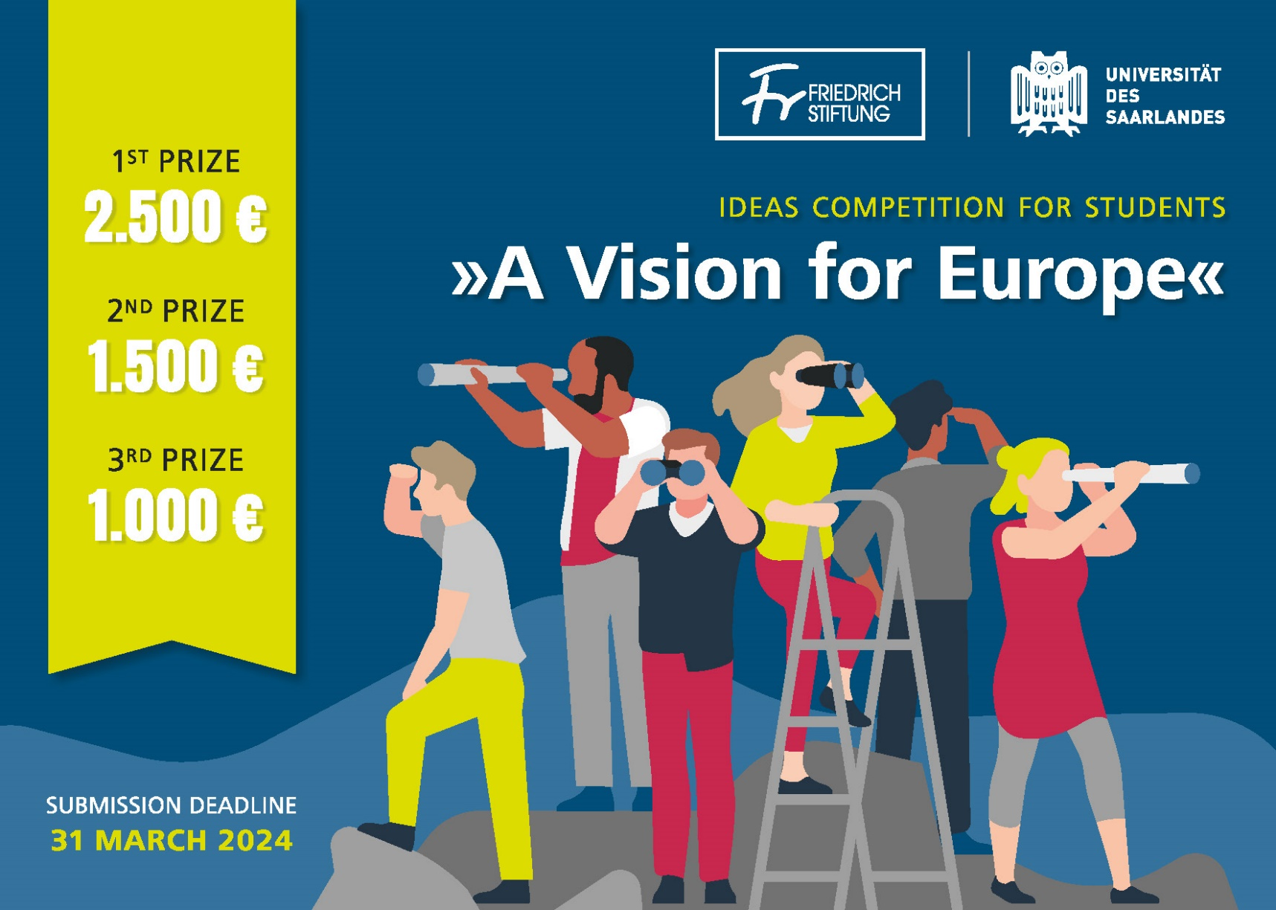
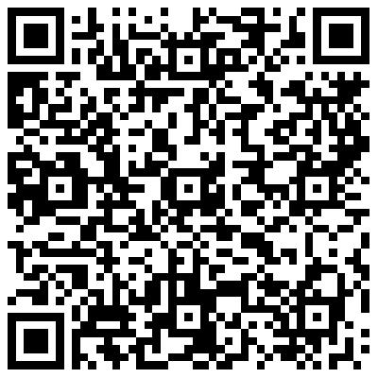
Student Competition „A Vision for Europe“
What are the ideas that ignite young people's passion for Europe? What are the facts, arguments and experiences that can inspire Europeans to build a better Europe for tomorrow?
Participants: Students of all subjects from Saarland University and partner universities in the alliance UniGR and Transform4Europe
Essay
Conceptual Sketch
Literary work
Graphic Short Story
Submission deadline:
31 March 2024
Link Website

