Slide 1


Fault Tolerance Was Available to Prevent Boeing 737 MAX Airplane Crashes and Their Costly Consequences
Algirdas Avižienis
Vytautas Magnus University, Kaunas, Lithuania and
University of California Los Angeles (UCLA), USA

Slide 2

Summary of the Presentation
The Goal of this presentation is to show that fault tolerance techniques for the Angle-of-Attack (AoA) sensors were available to prevent the fatal crashes of two Boeing 737 MAX airplanes: Lion Air Flight 610 and Ethiopian Airlines Flight 302. Regrettably, those fault tolerance techniques were not used by Boeing.
Part One describes a vulnerability (dormant design fault) that was created when MCAS was added to Flight Control Computer software. The vulnerability remained undetected after the first crash and led to the second crash and the grounding of the 737 MAX fleet for 20 months, waiting for MCAS redesign.
Part Two discusses the “Final Rule” document issued by FAA that states the design changes Boeing must perform in order to gain certification of the 737 MAX airplanes that were grounded. A pair of flaws of the document are identified and the unanswered question is repeated: “Why have FAA and Boeing avoided using fault tolerance of AoA sensors ?”
Note: multiple invitations were extended to Boeing to take part in a discussion of this presentation. No responses were received.

Slide 3
PART ONE
A Vulnerability Causes Disasters

Slide 4
Boeing 737 (Before MAX) Flight Crew Makes
Failure Decisions Based on AoA Sensor Outputs
There are two independent Flight Control Computers FCC: for the Captain and for the First Officer (the Flight Crew). One FCC is active, the other in “hot standby”. The choice is made by the Flight Crew in the Flight Deck (Figure 1).
Each FCC gets the input from one Angle-of-Attack sensor AoAs, located on each side of the aircraft (Figure 2). The AoA is the angle at which the chord of an aircraft's wing meets the relative wind. The chord is a straight line from the leading edge to the trailing edge of the wing (FAA definition).
Each FCC issues an Alarm (stick shaker and display) to its member of the Flight Crew when the AoA sensor output exceeds a preset limit and a stall may occur.
The Alarm is True (TA) if both AoAs send it, or False (FA) if only one AoAs sends it. FA is due to the failure of that AoAs, which is disregarded by Flight Crew for the rest of the flight and reported for repair.
Instructions to the Flight Crew how to deal with “Runaway Stabilizer” that I call “False Alarm” are contained in the Airplane Flight Manual AFM.

Slide 5
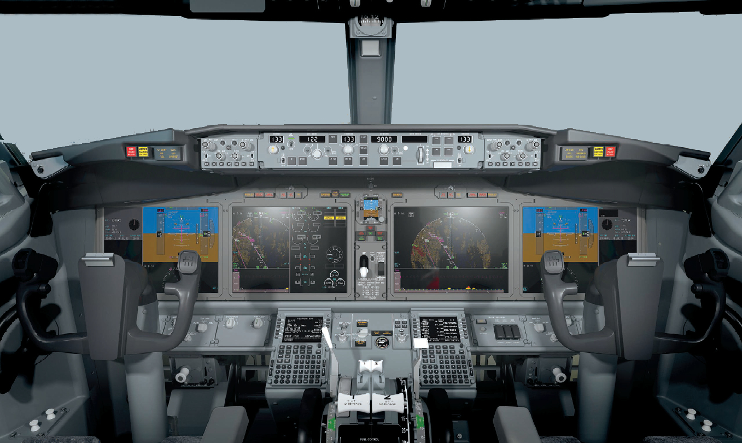
Fig. 1: The Flight Deck of Boeing 737 MAX Aircraft

Slide 6
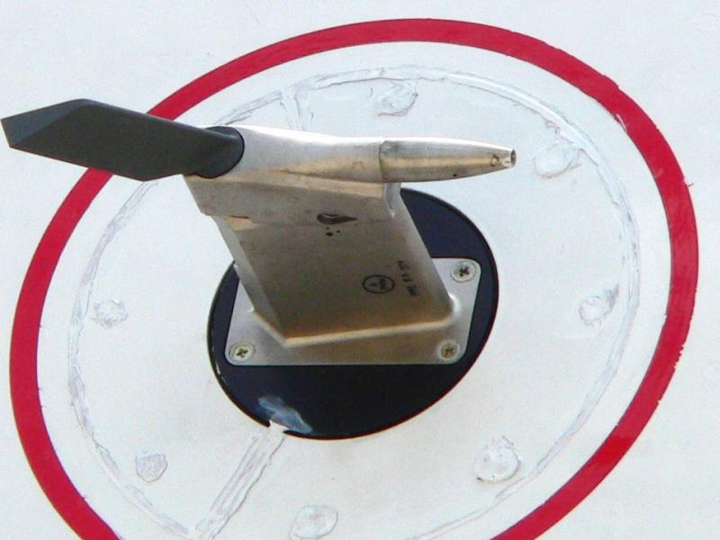
Fig. 2: The Vane: External Part of the Angle-of-Attack Sensor

Slide 7
Boeing Installs MCAS Software In 737 MAX
Airplanes
MCAS is “Maneuvering Characteristics Augmentation System”, a software system described in US Federal Register document FAA-2020-0686-001:
“MCAS is a function of the Speed Trim System (STS), which is part of the airplane’s flight control system. The STS provides automatic trim inputs to the horizontal stabilizer during manual flight. The STS uses data from a variety of sources, such as pitot tubes and the AOA sensors, to calculate when to make commands. MCAS is activated only during manual flight, with flaps up, and when the AOA sensors detect that the airplane is flying with a high AOA, such as when climbing aggressively or performing excessively tight turns with high bank angles. MCAS makes pitch trim commands to the horizontal stabilizer during a high AOA event so that the 737 MAX handling qualities are compliant with FAA regulations (including 14 CFR 25.173).”
Notes: [1]“high AOA event” means that the AoA sensors indicate that the airplane is flying with high AoA (an Alarm). [2] The existence of MCAS is not described in the original Airplane Flight Manual AFM for 737 MAX airplanes. [3] MCAS is an independent actor that does not communicate with the Flight Crew.

Slide 8
The Presence of MCAS Creates a
Vulnerability
“MCAS makes pitch trim commands” in the preceding slide means that when MCAS receives an AoAs Alarm, it acts independently of the Flight Crew. The Alarm may be True or False, but MCAS is not designed to make that distinction. MCAS will react to every Alarm.
The property of the design that MCAS will react to a False Alarm is a Vulnerability VB, also known as a Dormant Design Fault. MCAS will be activated, as required, by a True Alarm. However, when a failed AoAs issues a False Alarm, MCAS will start issuing “pitch trim commands” also.
The Flight Crew also receives the False Alarm message, but MCAS reacts to a False Alarm with electronic speed. The slower humans fall behind in time and must counteract already initiated nose-down trim commands from MCAS. They failed twice – in Lion Air Flight 610 and Ethiopian Airlines Flight 302.

Slide 9
Safety Certification of 737 MAX Misses the Vulnerability VB
The preceding Boeing models 737-100 to 737-700 had two AoA sensors and did not have any crashes due to AoA sensor failure. The Flight Crews could determine that an AoA sensor had failed and to disregard its False Alarms.
The 737 MAX flight control system differed from the previous models of 737 airplanes because it had the MCAS software. Safety analysis of the effects of MCAS should have discovered the Vulnerability VB and eliminated it before certifying 737 MAX airplanes, but VB was not found.
I will show that both 737 MAX crashes and subsequent grounding of 737 MAX fleet would have been avoided at the cost of two additional (redundant) AoA sensors per airplane.

Slide 10
Lion Air Flight 610 Crashes on Oct. 29, 2018
The vulnerability VB was the cause of the fatal crash of Lion Air Flight 610, killing all 189 persons on board. On November 7, 2018 FAA issued the Emergency Airworthiness Directive AD 2018-23-51 that stated in part (e) :
(e) Unsafe Condition*
This AD was prompted by analysis performed by the manufacturer showing that if an erroneously high single angle of attack (AOA) sensor input is received by the flight control system, there is a potential for repeated nose-down trim commands of the horizontal stabilizer. We are issuing this AD to address this potential resulting nose-down trim, which could cause the flight crew to have difficulty controlling the airplane, and lead to excessive nose-down attitude, significant altitude loss, and possible impact with terrain.”
*Note: this “Unsafe Condition” was the activation by “an erroneously high single angle of attack (AOA) sensor input” (to be called “False Alarm”) of the vulnerability VB in the flight control system, specifically in the STS (Speed Trim System), of 737 MAX that included MCAS.

Slide 11
FAA and Boeing Respond to
Lion Air Crash
By November 7, 2018 Boeing had determined that a False Alarm which originated in a failed AoA sensor had activated MCAS and caused the Lion Air crash. How did FAA act to prevent future disasters caused by such False Alarms?
FAA issued Emergency AD 2018-23-51 that required additions to the Airplane Flight Manual AFM. Those additions instruct the Flight Crew how to cope with the Unsafe Condition. Additions to the flight control system were not required by the Emergency AD. The vulnerability VB remained in all 737 MAX airplanes and caused the Ethiopian Airlines crash about four months later. The additions to the text of the Airplane Flight Manual were not sufficient to prevent that accident and the subsequent grounding of all 737 MAX airplanes.
It is regrettable that Boeing did not apply widely used methods that would prevent False Alarms from reaching MCAS input. Those methods are discussed next.

Slide 12
The Obvious Solution: Fault Tolerance of AoA Sensors
  Fault tolerance has been used in avionics for the past 60 years. For example, in the Apollo program the Saturn V launch vehicle guidance computer used majority decision fault tolerance. In the Space Shuttle four flight control computers formed a fault-tolerant array, with a fifth computer as a standby spare. Another good example is the Airbus A320 airliner that has been using a third AoA sensor for fault tolerance since the airplane began service in 1988.
  The news media and Boeing spokespersons blamed “MCAS malfunction“ for the Lion Air crash, that was wrong. MCAS function was to react to an Alarm, but MCAS was not designed to distinguish a False Alarm from a True Alarm.
  Therefore the obvious solution for 737 MAX was to prevent the „erroneously high single angle of attack (AOA) sensor input “ that I call “False Alarm” from reaching MCAS. That can be done by fault tolerance, using one or two redundant AoA sensors as discussed in the following slides.

Slide 13
Options to Solve the 737 MAX Vulnerability Problem
There were three well-known methods to augment 737 MAX flight control system after the Lion Air crash. They would have prevented the Ethiopian Airlines disaster with loss of 157 lives and the following grounding of all 737 MAX airliners. I want to emphasize that if one of these methods (QR or MD or DD) had been implemented in 737 MAX flight control system during the original certification process, then both 737 MAX crashes would not have occurred.
Instead, after Ethiopian Airlines crash FAA and Boeing decided to redesign MCAS software so that a False Alarm could arrive but would not cause fatal consequences. That effort took 20 months and kept the entire 737 MAX fleet grounded.
However, it was not sufficient just to redesign MCAS. The now required redesign of the 737 MAX also requires implementing the DD method of MCAS shutdown that is the weakest of the three methods described next.

Slide 14
Method QR: Quad Redundancy QR with 4 AoA Sensors
The Quad Redundancy QR method requires the installation of one more AoA sensor on each side of the airplane. The two sensor vanes should be adequately separated to avoid damage to both by one event – impact by a big bird, or contact by ground equipment before takeoff.
This QR method tolerates two AoA sensor failures and shuts down MCAS after the third AoA sensor fails. QR performs MD after the second failure and DD after the third failure. Therefore QR could be safely used with the original MCAS.
I have devised the QR method described here and offered it to Boeing free of charge, but received no response. It is possible that it has been used before, but I have not seen a published description. My implementation of QR is described in the next slide.
There are two other advantages of QR: (1) it tolerates the simultaneous loss of both AoA sensors on the same side; and (2) design diversity can be introduced by procuring the AoA sensors on the same side from two independent sources.

Slide 15
Implementation of My Quad Redundancy (QR) Method copyright 2020 by Algirdas Avizienis
Mark the AoA sensor outputs L1,L2 (Left 1 and 2), R1,R2 (Right 1 and 2)
Connect L1,L2,R1,R2 to Left FCC and Right FCC
Each FCC performs 6 comparisons: L1?L2, L1?R1, L1?R2, L2?R1, L2?R2, R1?R2
Each comparison has one of two outcomes: Agree A or Disagree D
D is issued when the difference between two AoA sensor outputs exceeds a given value for a specified time
If all comparisons Agree, there is no AoA sensor failure
If sensor sL1 fails, L1?L2, L1?R1, L1?R2 yield D while L2?R1, L2?R2,R1?R2 yield A
Both FCCs disconnect L1 (failure of sL1 is tolerated) and 3 good sensors remain
The same procedure is applied if sensor sL2 or sR1 or sR2 fails first
If later one more sensor fails then the MD method (shown next) is applied
Note: My free offer of the QR algorithm to Boeing is herewith revoked. Boeing may use my QR method for a $ 1 million donation to my favorite charities.

Slide 16
Method MD: Majority Decision MD with 3 AoA Sensors
The Majority Decision (MD) method requires the installation of a third AoA sensor, preferably equidistant from the other two. Majority Decision is used to identify the failed AoA sensor. Allowances must be made for the separation of AoA sensors in deciding that a disagreement exists. MD is also applied when 3 AoA sensors are left after the first sensor failure in the QR implementation.
After the failed AoA sensor is disconnected (one failure has been tolerated), the remaining two AoA sensors use the DD method to safely shut down the MCAS if one more AoA sensor fails.
I emphasize that three AoA sensors have been used by all Airbus A320 airplanes since 1988 and, as far as I have been able to determine, no crashes have been attributed to AoA sensor failures.

Slide 17
Implementation of the Majority Decision (MD) Method
Mark the AoA sensor outputs L (Left), R (Right), and M (Middle)
Connect L, R, and M to Left FCC and Right FCC
Both FCCs perform 3 comparisons: L?R, L?M, R?M
Each comparison has two outcomes: Agree A or Disagree D
D is issued when the difference between two outputs exceeds a given value for a specified time
If all comparisons agree: L?R=A, L?M=A, and R?M=A there is no sensor failure
If the left sensor sL fails, R?M=A, but L?R=D and L?M=D
Both FCCs disconnect L (failure of sL is tolerated) and perform R?M only
The same procedure is applied if sensor sR or sensor sM fails first
If later R?M=D then the DD method is applied and both FCCs disconnect ( shut down) their MCAS software.

Slide 18
Method DD: Disagree Detector DD of Two AoA Sensor Outputs
The DD method is now required by FAA to be installed in the re-certified 737 MAX airplanes. The DD is called “Split Vane Monitor“ in Boeing literature.
The DD method does not tolerate AoA sensor failures. Upon the first AoA sensor failure the FCC shuts down MCAS because it cannot determine and disconnect the failed sensor.
The DD method was not used in 737 MAX until it was required by FAA. Since 1968 all Boeing 737 airplanes, including 737 MAX, had only two AoA sensors – one on each side, providing the input to the FCC on that side only.
The activation of the MCAS by a False Alarm from a failed AoA sensor is avoided in re-certified 737 MAX airplanes by providing a Disagree Detector DD in each FCC that compares the outputs of both AoA sensors and disconnects MCAS when the difference of the outputs reaches a preset value, which currently is " greater than 5.5 degrees for a specified period of time“. The failure of a sensor causes the killing of the MCAS !

Slide 19
The Disadvantages of the DD Method
When the DD method is used, the comparison of AoA sensor outputs does not reveal which one of two AoA sensors has failed, that is, which AoA output (of two) has reached the erroneously high value resulting in a False Alarm. AoA data from both sensors becomes not trustworthy for the use in MCAS and in computing other flight parameters. Since the failed AoA sensor cannot be disconnected, MCAS has to be disconnected in both FCCs.
The resulting disadvantage of the DD method is that after its activation the rest of the flight is without MCAS support. Therefore safety of the flight cannot depend on having MCAS support for the entire flight. FAA asserts that flight without MCAS meets their safety requirements. The absence of MCAS support may cause additional pressure on the Flight Crew when an actual risk of a stall (True Alarm) happens. MCAS was intended to assist the Flight Crew during a True Alarm.
Regardless of the disadvantages, the re-certified 737 MAX airplanes use the DD method to cope with the first AoA sensor failure by disconnecting MCAS for the remainder of the flight.

Slide 20
The Immense Costs of Not Choosing Fault
Tolerance (1)
After the crash of Ethiopian Airlines Flight 302, 346 lives had been lost and the entire 737 MAX fleet was grounded on March 13, 2019. FAA and Boeing had to decide how to return the airplanes to service. Available were two choices to use state-of-the-art methods, and the very costly (2) was chosen:
(1) Install redundant AoA sensors on both sides (the QR method, more effective than MD) and write the simple Comparison software that identifies and disconnects the failed AoA sensor. Changes in MCAS software were not necessary because QR tolerates two AoA sensor failures and shuts down AoA sensor inputs to MCAS after the third failure. Therefore MCAS never receives a False Alarm that activates the vulnerability.
(2) Rewrite the MCAS software to make sure that MCAS will not generate the series of commands that caused the two 737 MAX crashes when MCAS received a False Alarm. It still is necessary to disable MCAS by the Disagree Detector DD software after the DD detects that a specified value of disagreement between the two AoA sensor outputs is exceeded for a specified time.

Slide 21
The Immense Costs of Not Choosing Fault
Tolerance (2)
The FAA issued Airworthiness Directive AD 2020-24-02, effective November 20, 2020 which listed the requirements that every 737 MAX airplane had to satisfy to be re-certified for passenger transport. They included the new MCAS and DD.
The grounding order for the 737 MAX fleet lasted from March 13, 2019 to November 20, 2020 (a total of 20 months). To be added is the time after November 20 needed to satisfy FAA requirements stated in AD 2020-24-02 before an airplane is recertified.
On January 7, 2021 The New York Times wrote:
“Last January, Boeing said it expected the plane’s grounding to cost the company more than $ 18 billion. But that was before the coronavirus pandemic brought travel to a standstill, throwing the airline industry into disarray. In 2020, Boeing lost more than 1,000 aircraft orders, mostly for the Max, though more than 4,000 remain.” (Authors: Niraj Chokshi and Michael S. Schmidt)

Slide 22
Three Strikes and Boeing Is Out...of
$ 18 Billion + and 346 Persons Are Out… of Their Lives
There were three opportunities for FAA and Boeing to decide to implement the Quad Redundancy (QR) or Majority Decision (MD) method of fault tolerance for the AoA sensors in the Boeing 737 MAX airplane:
During the original certification of the 737 MAX airplane;
After the crash of Lion Air Flight 610;
After the crash of Ethiopian Airlines Flight 302.
It is a sad story: they missed all three due to reasons that only the FAA and Boeing can shed light on. Would they please reveal the reasons ? I regret that Boeing did not respond to multiple invitations to comment on this presentation at DSN 2021.
The cost of QR per airplane is evident: install two more AoA sensors, and do six Disagreement comparisons instead of one in the Disagree Detector (DD) program (same for all airplanes) in the two Flight Control Computers FCC.
The total cost of Boeing’s “MCAS redesign” approach: $ 18 billion, or more?
Please note: the original MCAS software did not need to be changed if the QR or MD method was chosen, because only True Alarms would be received by MCAS, while False Alarms would be intercepted by fault tolerance.

Slide 23
PART TWO
The FAA “Final Rule” Has Two Flaws

Slide 24
FAA Ends the Investigation, Issues “Final Rule” Document
FAA concluded its investigation of the causes of two fatal crashes of Boeing 737 MAX airplanes and of the means to remove those causes by the following actions:
(1) Issuing the Notice of Proposed Rulemaking FAA-2020-0686-0001 on August 6, 2020 and requesting “comments on this proposed AD” by September 21, 2020
(2) Issuing the Final Rule AD 2020-24-02 effective November 20, 2020. This 34 page document states the actions that Boeing must perform in order to get the 737 MAX airplanes re-certified. This AD also summarizes about 240 public comments that were received and responds to each group of comments.
The Final Rule document also acknowledges 3 expert groups that contributed to this study. They were: Joint Operational Evaluation Board (JOEB), Flight Standartization Board (FSB), and Technical Advisory Board (TAB).

Slide 25
FAA Seeks Advice from an International Expert Team
On June 1, 2019 FAA chartered the “Boeing 737 MAX Flight Control System Joint Authorities Technical Review” (JATR). The review team was led by Christopher A. Hart and consisted of experts from FAA and NASA and civil aviation authorities from Australia, Brazil, Canada, China, the European Union, Indonesia, Japan, Singapore, and the United Arab Emirates. Mr. Hart delivered the 70 page JATR Report to Mr. Ali Bahrami, FAA Associate Administrator for Aviation Safety on October 11, 2019.
Chapter 6 of the JATR Report, entitled “Holistic, Integrated Aircraft-Level Approach” contains Recommendation 6.3 that is stated below:
Recommendation R6.3: The FAA should implement policies and further guidance to reinforce that all system functions that are used in flight critical functions should implement means for increased fault tolerance, such as signal health monitoring, voting means, and failure annunciation. Increased system fault tolerance should be sought to the extent practicable to accommodate unforeseen scenarios or unconfirmed assumptions during system operation.

Slide 26
JATR Experts Find Weaknesses in Boeing’s
Design (Recommendation R6.3 continued)
This recommendation is based on Findings F6.1-A, F6.1-B, and F6.1-C.
Finding F6.1-A: The JATR team identified that the design process was not sufficient to identify all the potential MCAS hazards. As part of the single-channel speed trim system, the MCAS function did not include fault tolerant features, such as sensors voting or limits of authority, to limit failure effects consistent with the hazard classification.
Finding F6.1-B: The use of pilot action as a primary mitigation means for MCAS hazards, before considering eliminating such hazards or providing design features or warnings to mitigate them, is not in accordance with Boeing’s process instructions for safe design in the conception of MCAS for the B737 MAX.
Finding F6.1-C: The JATR team found that there was a missed opportunity to further improve the system design through the use of available fail-safe design principles and techniques presented in AC 25.1309-1A and in EASA AMC 25.1309 in the MCAS design.
End of Recommendation R6.3

Slide 27
FAA and Boeing Disregard JATR
Recommendation R6.3
The Final Rule document AD 2020-24-02 identifies three expert groups that have contributed to the 737 MAX failure investigation but does not mention the expert group JATR and its Recommendations at all. That is an unjustified omission because Mr. Christopher A. Hart, the Team Chair of JATR, submitted the “Boeing 737 MAX Flight Control System Joint Authorities Technical Review” to Mr. Ali Bahrami, FAA Associate Director for Aviation Safety on October 11, 2019.
Contrary to Recommendation R6.3 of JATR Report the required design changes in the Final Rule document do not include fault tolerance and remain with the two non-redundant AOA sensors that originally were the design choice for the Boeing 737-100 and 737-200 in the 1960s.
FAA also has rejected appeals from A. Avizienis to require AoA sensor fault tolerance. My communications with FAA are discussed later. I am disappointed that my offer of expertise in fault tolerance was not accepted by FAA.

Slide 28
FAA Explains “Redundant”, Makes a Mistake
In the “Final Rule” document responses are provided for comments received from interested individuals, groups, and organizations. One case is from “Final Rule” document AD 2020-24-02 :
Comment summary : The Families of Ethiopian Airlines Flight 302 asked whether the two AOA sensor inputs to MCAS are truly redundant.
FAA response: The two AOA sensors and the data they provide are independent, and are therefore redundant in that the failure of one AOA sensor does not impede the operation of the other AOA sensor. end of quote
The “FAA response” is wrong. The AoA sensors cannot be both independent and redundant with respect to each other at the same time. In this case the two AoA sensors are independent and not redundant.
For example, the two AoA sensors that are added to implement the Quad Redundancy (QR) method of fault tolerance are redundant with respect to the original two (not redundant, but independent) AoA sensors.

Slide 29
The First Failure of an AoA Sensor
Disables MCAS and the FAA Mistake Gets
Worse
Final Rule document AD 2020-24-02 states:
“Based on analyses, simulation, and flight testing to establish consequences of failures and the capability for continued safe flight and landing, the FAA has determined that the new MCAS meets FAA safety standards, and that it is acceptable for STS* (including MCAS) to remain inoperative for the remainder of a flight after the system fails. Therefore, the additional redundancy requested by commenters, to increase the availability of the system, is not required.” *Note: STS is the Speed Trim System, a part of the flight control system.
The words “additional redundancy” imply that redundancy already exists in the STS. That is wrong. The preceding slide has shown that the two AoA sensors are not redundant, as FAA erroneously claims. Therefore the QR method “requested by commenter” Algirdas Avizienis would be the first redundancy for the AoA sensors of an Boeing 737 airplane since the Boeing 737-100 started flying in 1968.
THE MISTAKE: FAA says “we have enough redundancy” while they have none !

Slide 30
FAA Refuses Unsolicited Advice
All the effort of proving that 737 MAX can fly safely without MCAS that was described in AD 2020-24-02 would not have been necessary if “the additional redundancy requested by commenters” , that is – the QR method requested by “commenter” Algirdas Avizienis, had been implemented. QR would disable STS only after the third failure (out of 4) of AoA sensors, a most unlikely event in one flight.
A summary of my unsuccessful efforts to convince FAA that the QR method was the best (and inexpensive) improvement in the design additions to 737 MAX flight control system is presented in the next two slides. Regrettably, the re-certified 737 MAX airplanes are flying today with the non-redundant pair of AoA sensors, just as the Boeing 737-100 flew in 1968.

Slide 31
My Efforts to Convince FAA to Require
Fault Tolerance: 9 Tries, 4 Replies, but No Success
05/15/2019 my email to Mr. Ali Bahrami, Associate Administrator for Aviation Safety, a “thank you“ note comes the next day
09/11/2019 my email to Mr. Bahrami, attached a two page paper on the causes of failure of 737 MAX airplanes
10/06/2019 my email “An Appeal to add two AoA sensors to 737 MAX” to Mr. Bahrami
10/20/2019 my email “Comments on JATR report” to Mr. Bahrami
11/06/2019 I receive US Mail from Mr. Earl Lawrence, Executive Director of Aircraft Certification Service, responding to my letters to Mr. Bahrami : “we appreciate your interest...”
12/14/2019 my email: expanded “Appeal” with 5 exhibits to Mr. Lawrence and Mr. Bahrami
01/20/2020 I send US Certified Mail to Mr. Lawrence with a Summary Report of my arguments for adding two redundant AoA sensors and implementing the QR method of fault tolerance in Boeing 737 MAX airplanes

Slide 32
My Efforts to Convince FAA to Require Fault Tolerance: Ending with the Final Rule
02/07/2020 Two-hour telephone call from Mr. George Romanski, FAA Chief Scientific and Technical Advisor for Aircraft Computer Software
02/10/2020 my email: comments about the telephone discussion to Mr. Romanski, Mr.Lawrence, and Mr. Bahrami
02/19/2020 US Mail from Mr. Lawrence about my letters of 01/20 and 02/10/20: “we will do the right thing”
09/21/2020 I submit the formal comment “The Case for Fault Tolerance of AoA Sensors in Boeing 737 MAX Aircraft”. My comment is assigned the document identification FAA-2020-0686-0183.
10/20/2020 The Final Rule document states: “Based on analyses, simulation, and flight testing to establish consequences of failures and the capability for continued safe flight and landing, the FAA has determined that the new MCAS meets FAA safety standards, and that it is acceptable for STS (including MCAS) to remain inoperative for the remainder of a flight after the system fails. Therefore, the additional redundancy requested by commenters, to increase the availability of the system, is not required.”

Slide 33
In Conclusion: It Is Not Too Late to Make Things
Better for the Boeing 737 MAX Airplane
At this time the re-certified 737 MAX airplanes are flying with the single Disagree Detector DD comparison that disconnects MCAS in both FCCs for the remaining duration of the flight after the first one (of two) nonredundant AoA sensor fails.
The inexpensive installation of the QR method of fault tolerance would assure that MCAS is disconnected only after 3 (out of 4) AoA sensors fail.
I believe that installing QR now would benefit Boeing by raising the confidence of the traveling public in the safety of the 737 MAX airplane. There is no more need “to fly without MCAS” – that just does not sound good for nonexpert travelers.
In concluding my presentation I repeat the “18 billion dollar+ question”: “Why have FAA and Boeing avoided fault tolerance of AoA sensors even after the Ethiopian Airlines disaster ?”
We have seen that an extra pair of AoA sensors would have made any changes to the original MCAS (and 20 months of grounding the MAX fleet) unnecessary.
If installed as part of the original certification, two additional AoA sensors would have prevented both 737 MAX airplane crashes !

Slide 34
That’s All, Folks
Your Questions, Please
Algirdas Avižienis - in Lithuania and in publications
Al Avizienis - to my colleagues and friends everywhere else
Please submit your written questions and comments to avizienisa@gmail.com

